Slide 1

HOTEL RESERVATION ANALYSIS WITH MYSQL WORKBENCH
By Raunak Saini
Batch Name: MIP-DA-10
Profile:- Data Analysis Intern

Slide 2

Project Objective: Analyzing a hotel reservation dataset using MYSQL workbench.
Importance: Enhancing data analysis skills in a practical context.
3) Data Details: Key columns and their significance.

Slide 3

PROBLEM ANALYSIS
Import dataset into MySQL workbench
Observation & Understanding of Data
Getting Insights from Data by Writing Queries

Slide 4
PROJECT DATASET DETAILS:
Booking_ID: A unique identifier for each hotel reservation.
no_of_adults: The number of adults in the reservation.
no_of_children: The number of children in the reservation.
no_of_weekend_nights: The number of nights in the reservation that fall on weekends.
no_of_week_nights: The number of nights in the reservation that fall on weekdays.
type_of_meal_plan: The meal plan chosen by the guests.
room_type_reserved: The type of room reserved by the guests.
lead_time: The number of days between booking and arrival.
arrival_date: The date of arrival.
market_segment_type: The market segment to which the reservation belongs.
avg_price_per_room: The average price per room in the reservation.
booking_status: The status of the booking.

Slide 5

DATABASE USED:
MySQL Workbench

Slide 6
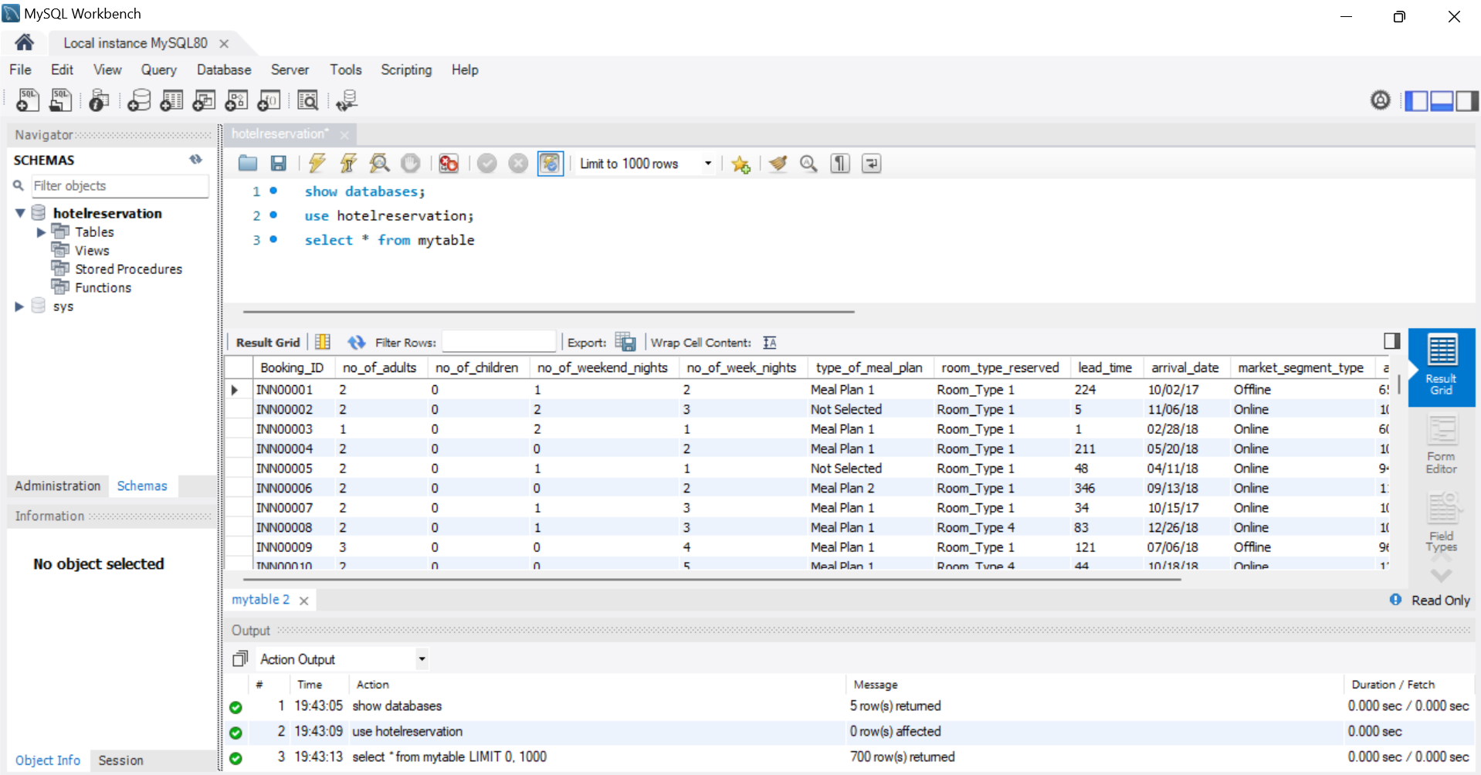
MySQL WORKBENCH INERTFACE

Slide 7
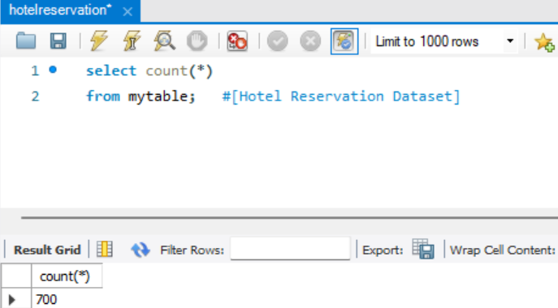
What is the total number of reservations in the dataset?
LETS START WITH QUERIES

Slide 8
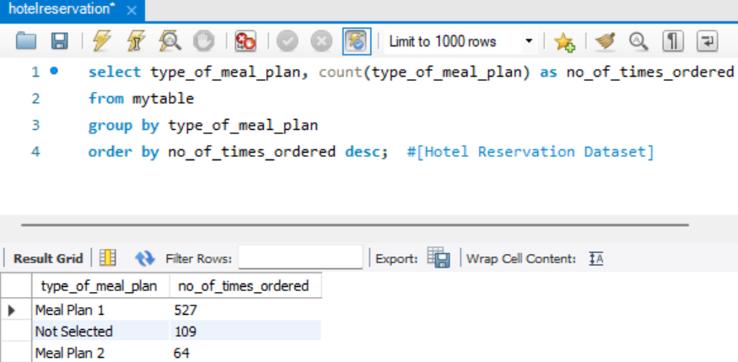
Which meal plan is the most popular among guests?

Slide 9
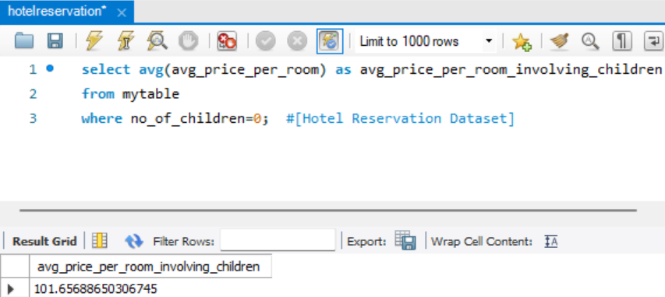
What is the average price per room for reservations involving children?

Slide 10
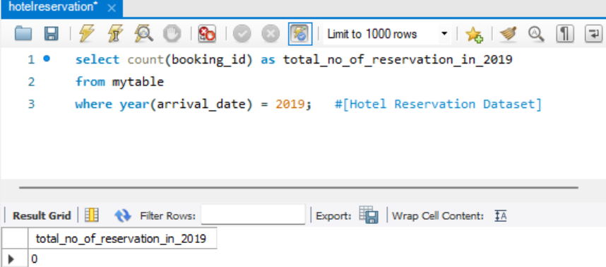
How many reservations were made for the year 20XX (replace XX with the desired year)?

Slide 11
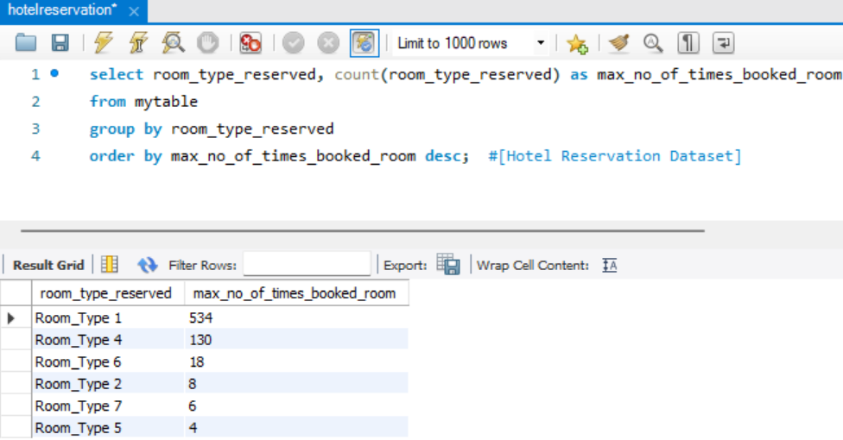
What is the most commonly booked room type?

Slide 12
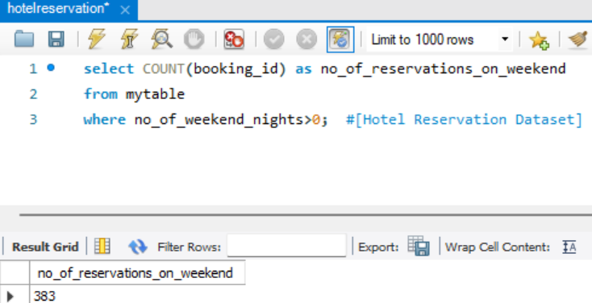
How many reservations fall on a weekend (no_of_weekend_nights > 0)?

Slide 13
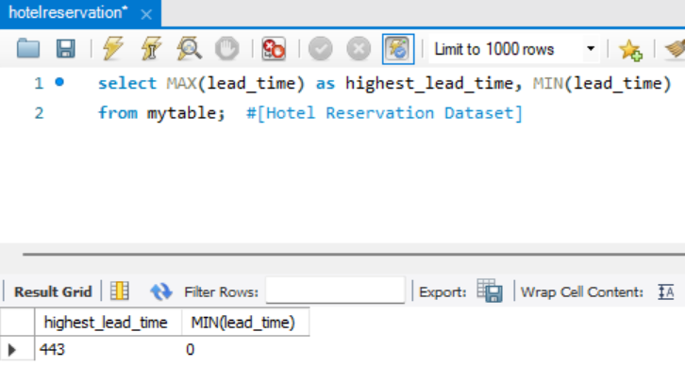
What is the highest and lowest lead time for reservations?

Slide 14
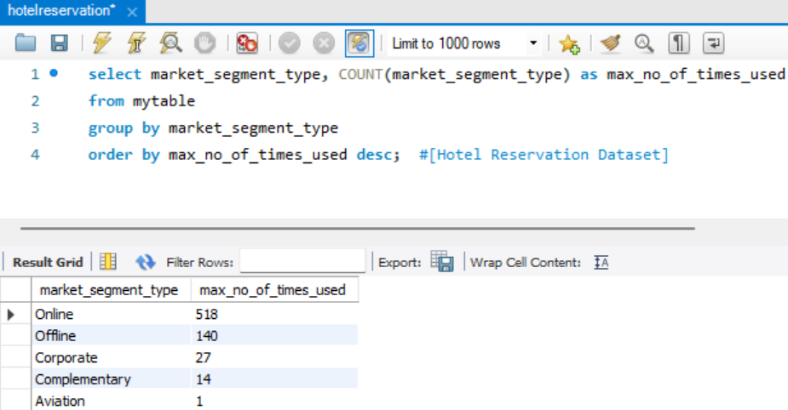
What is the most common market segment type for reservations?

Slide 15
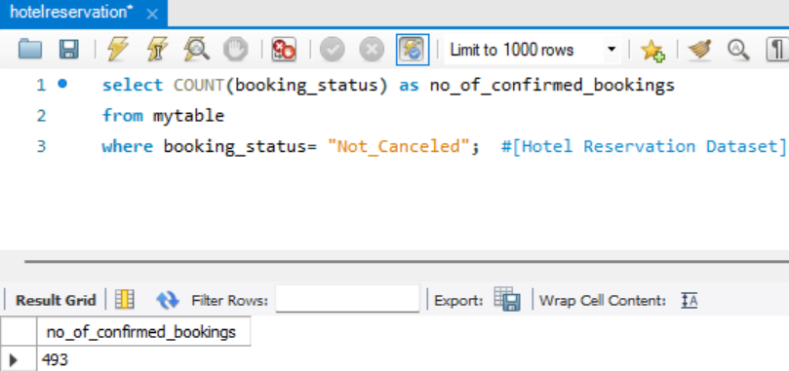
How many reservations have a booking status of "Confirmed"?

Slide 16
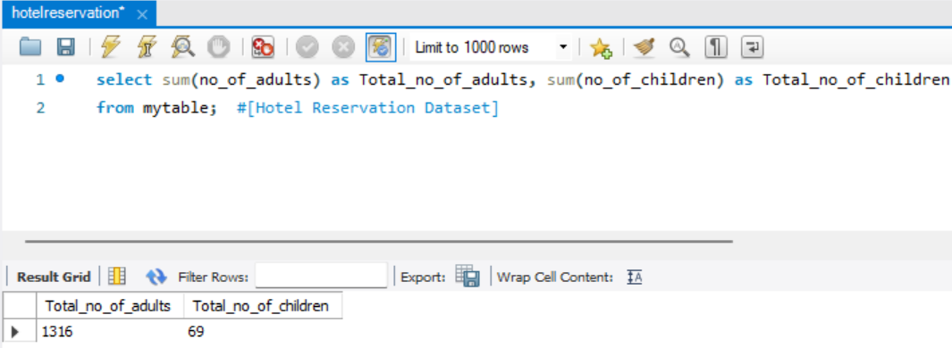
What is the total number of adults and children across all reservations?

Slide 17
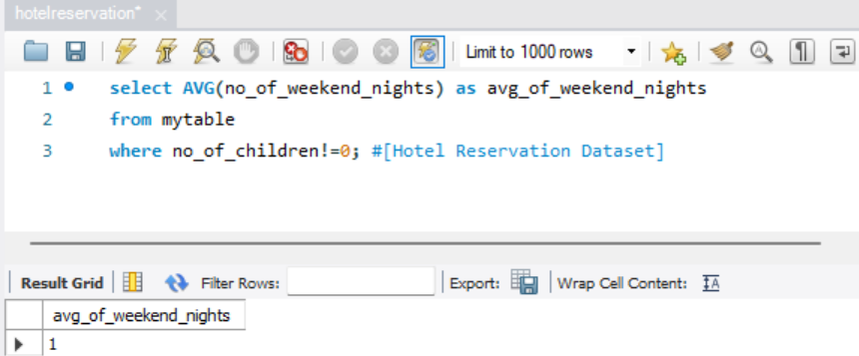
What is the average number of weekend nights for reservations involving children?

Slide 18
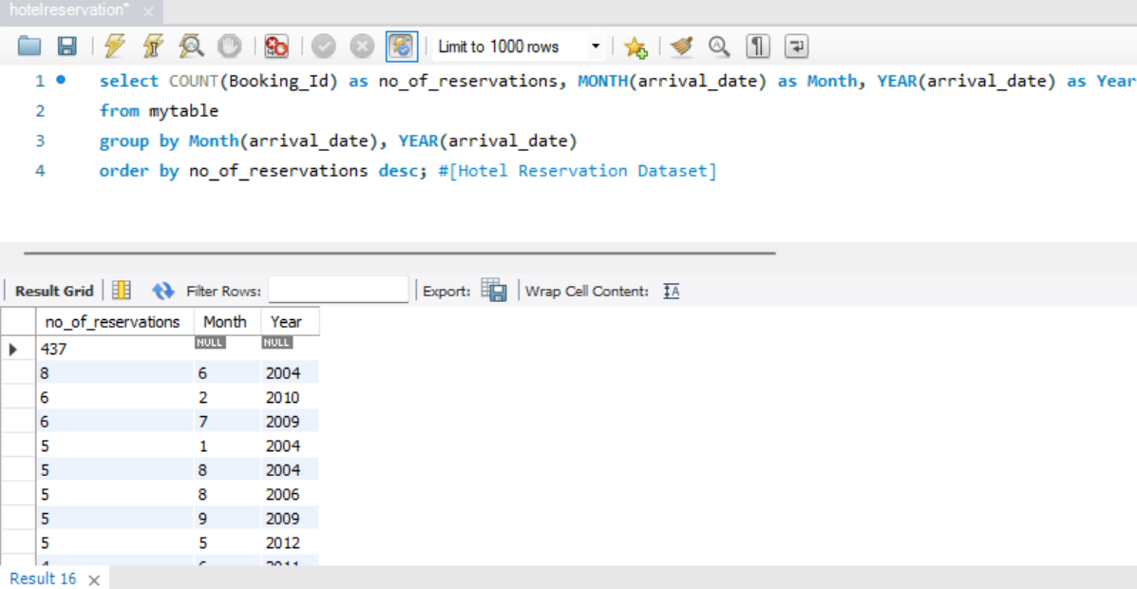
How many reservations were made in each month of the year?

Slide 19
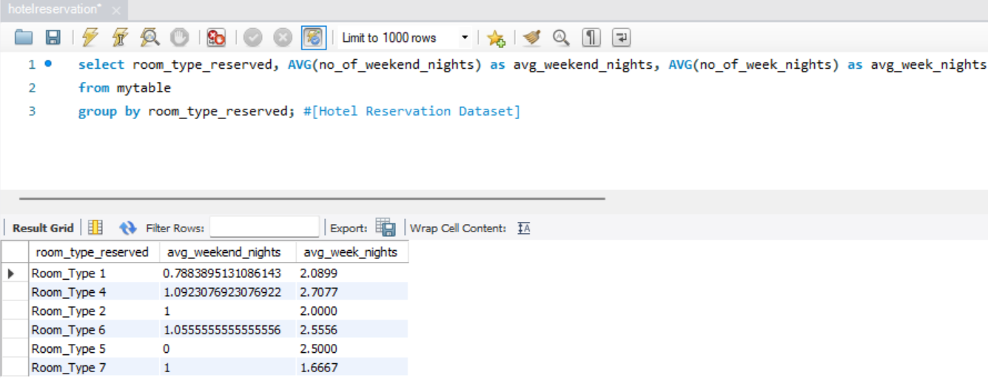
What is the average number of nights (both weekend and weekday) spent by guests for each room type?

Slide 20
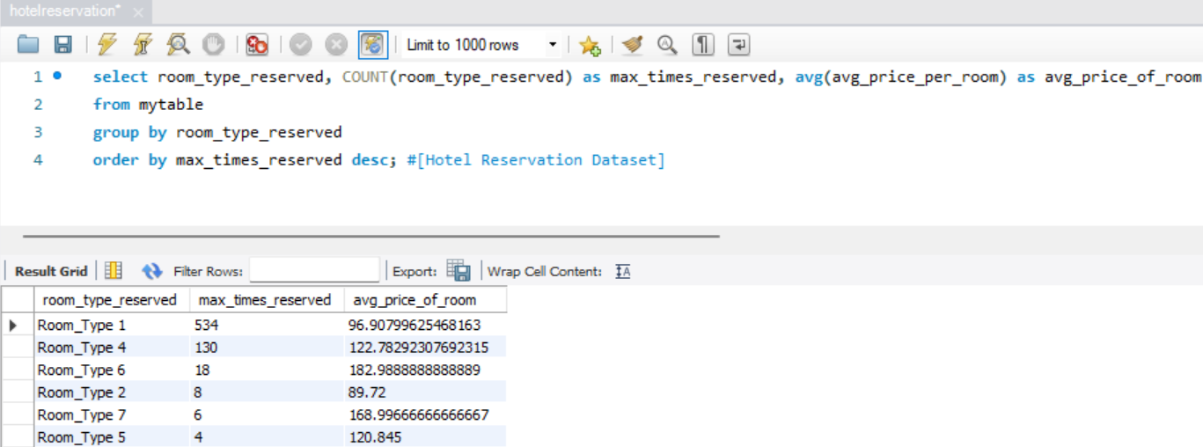
For reservations involving children, what is the most common room type, and what is the average price for that room type?

Slide 21
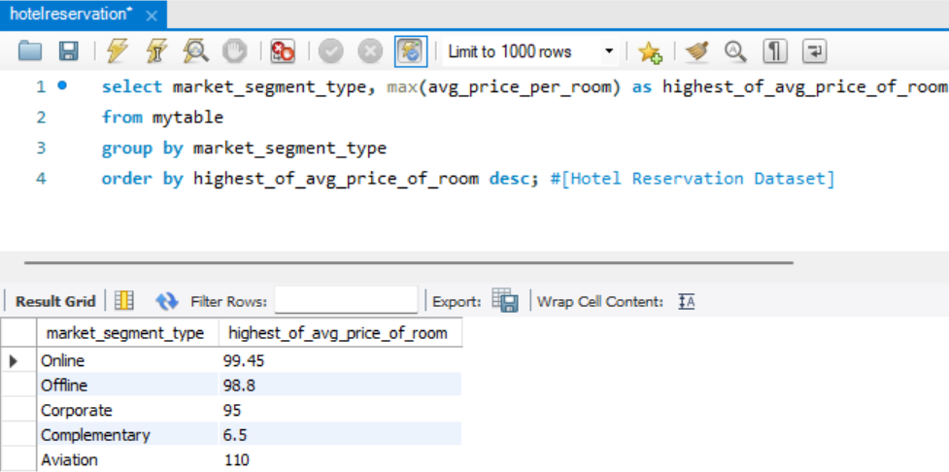
Find the market segment type that generates the highest average price per room.

Slide 22
CONCLUSION:
The analysis of the hotel reservation datasets reveals valuable insights for informed decision-making in the hospitality industry. Understanding guest preferences, popular meal plans, room types, booking trends, and market segments allows hotel to tailor their offerings, optimize pricing strategies, and enhance the guest experience.

Slide 23
Thank You

